Slide 1
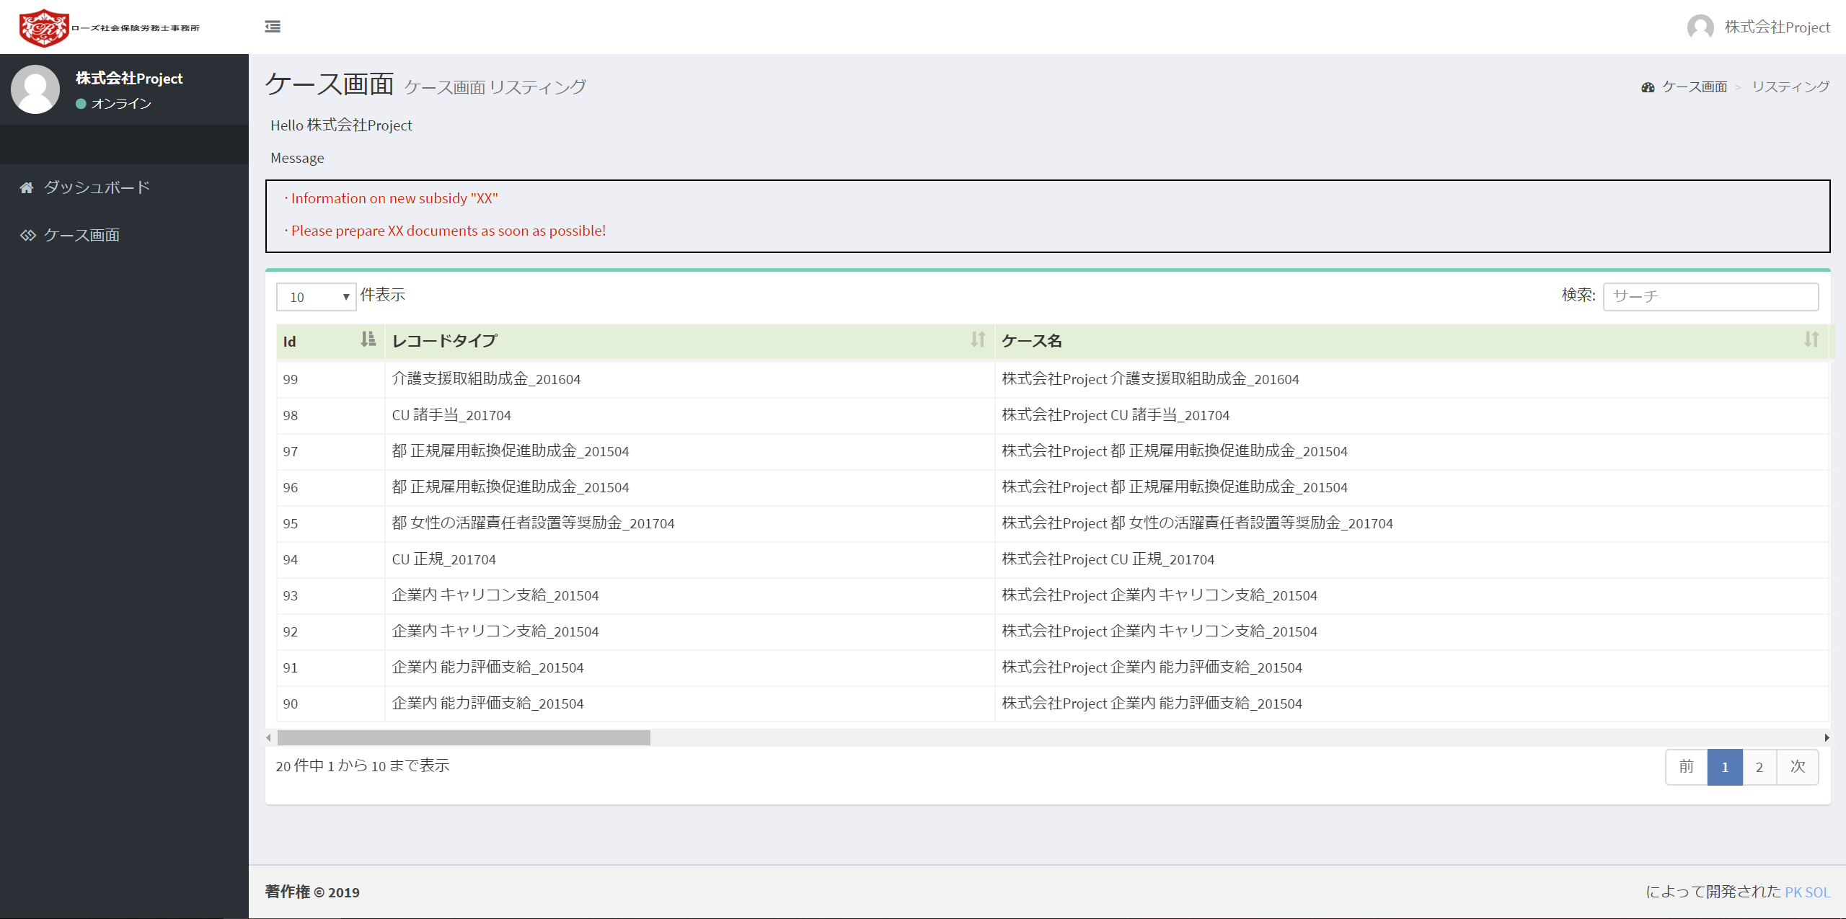
【20190314b】Not yet done User > case screen
No need “Hello”
Please change like bellow
“顧客名” 様
Example)
株式会社Project 様
Not yet done

Slide 2
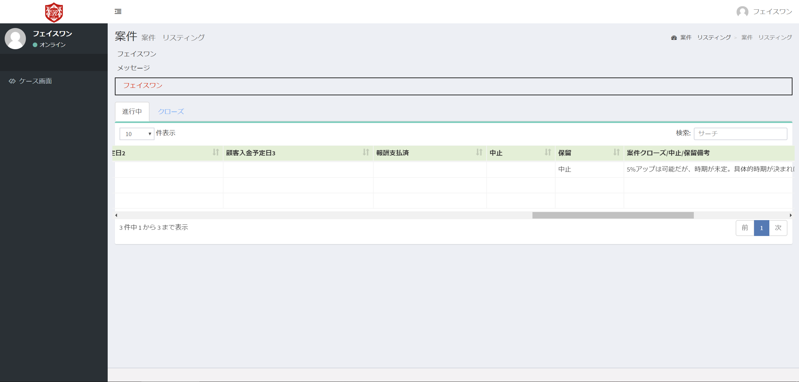
【20190318a】Not yet done
Correct the wording
保留
This column is “保留” column. So please put “保留” if the value is true.

Slide 3
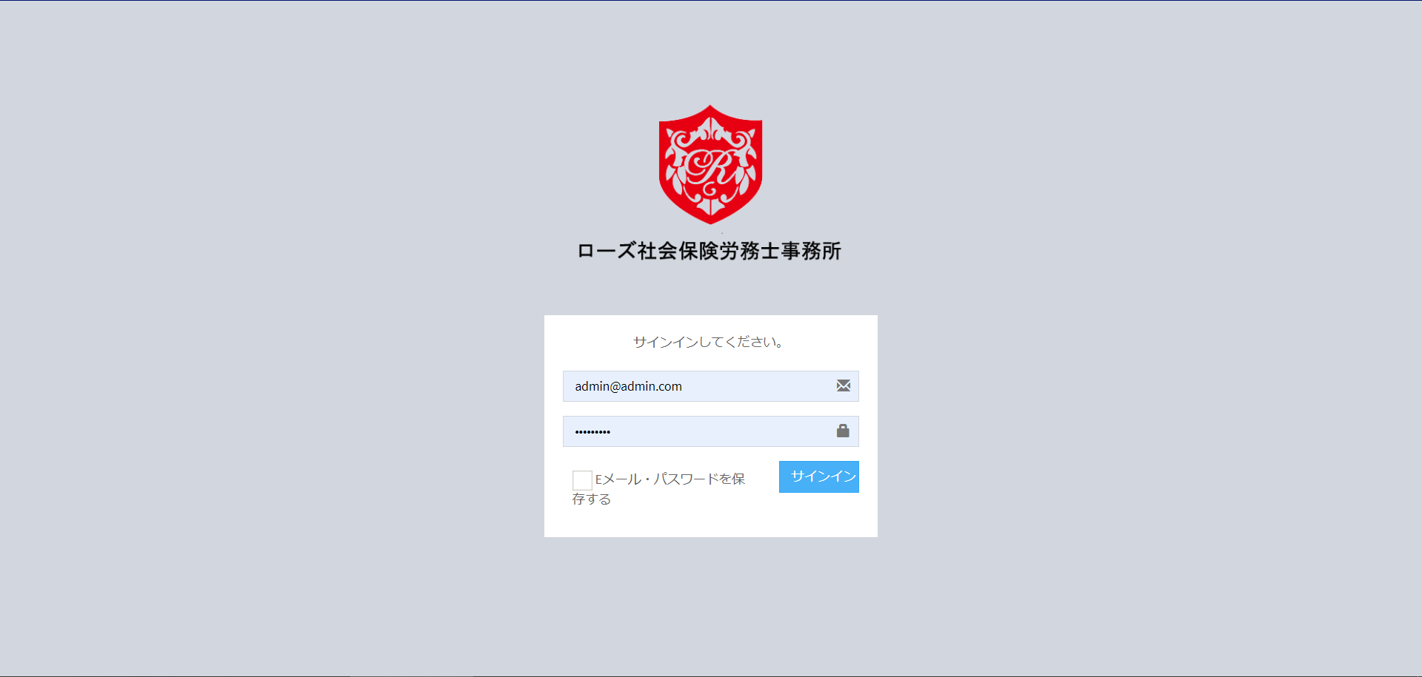
Login screen
Font = Meiryo UI
I want to make one line.
If not possible, only
“パスワードを保存”
Centered
(Not right)

Slide 4
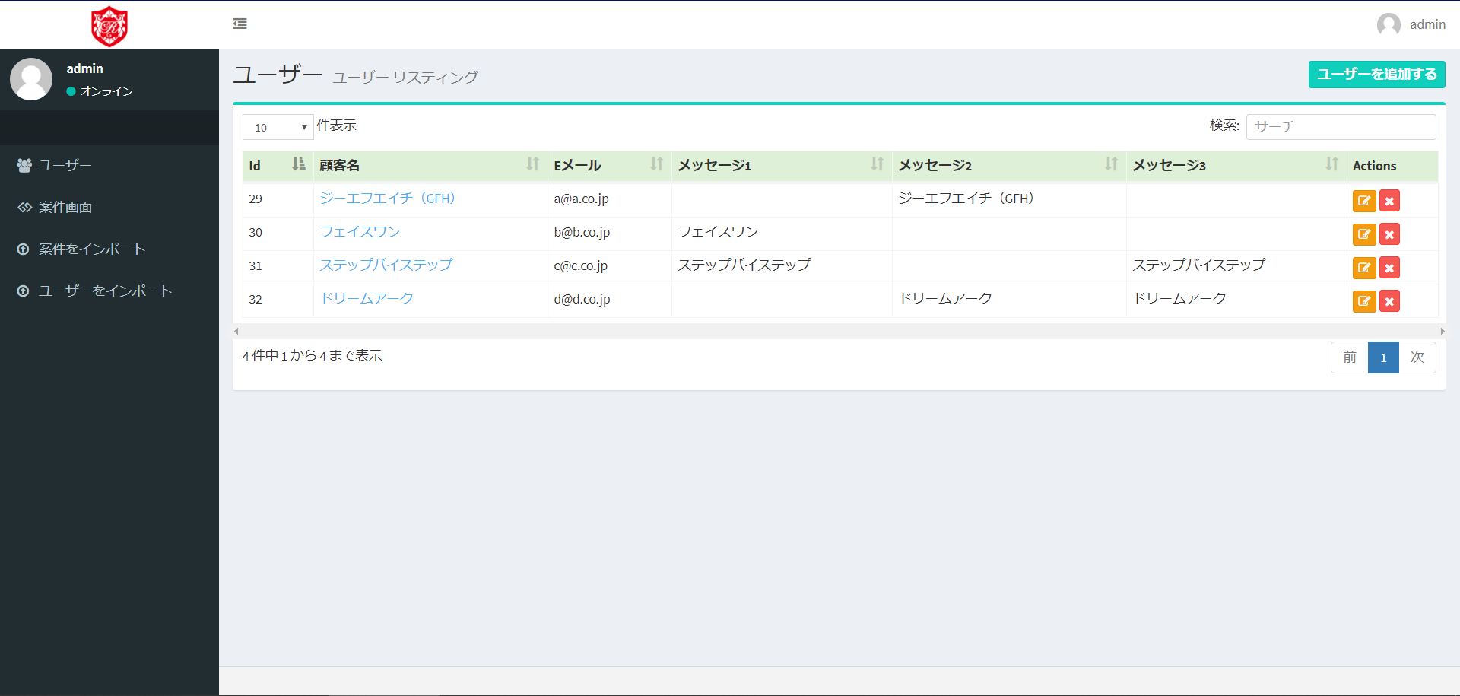
Admin > ユーザー
No need this Description.

Slide 5
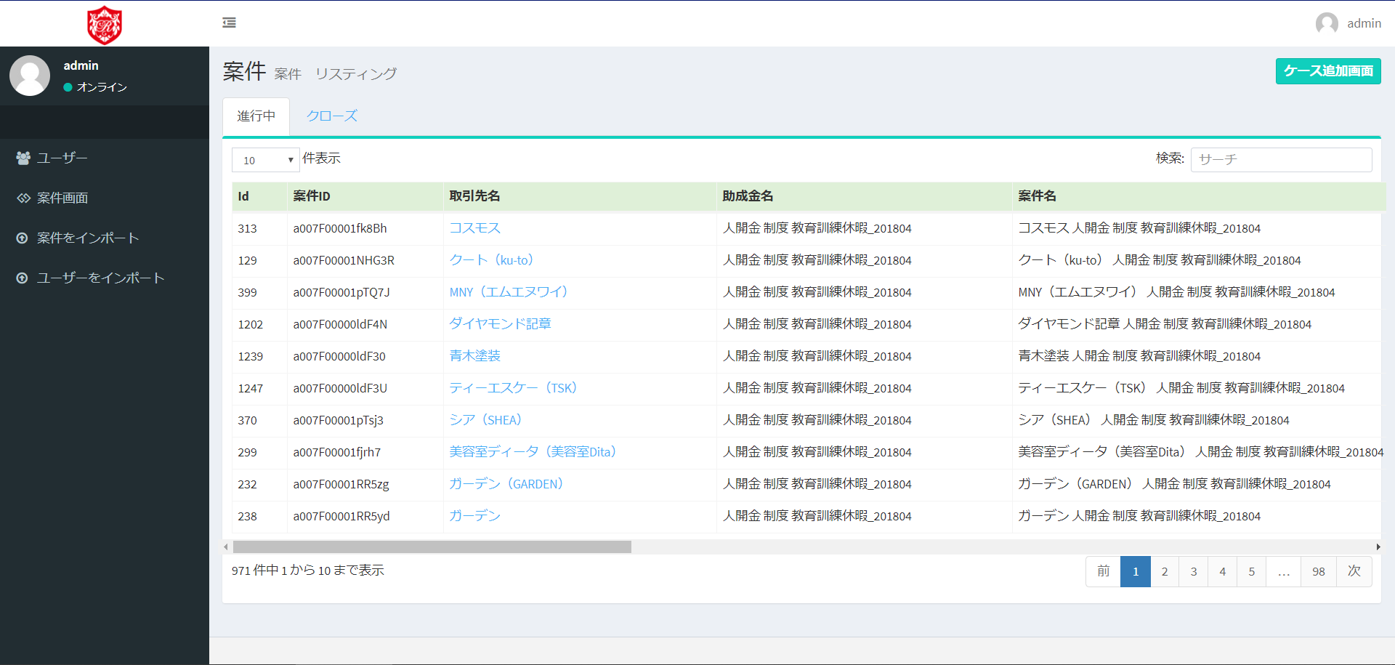
Admin > 案件画面
Not ケース追加画面
But 案件追加画面
No need this Description.
案件

Slide 6
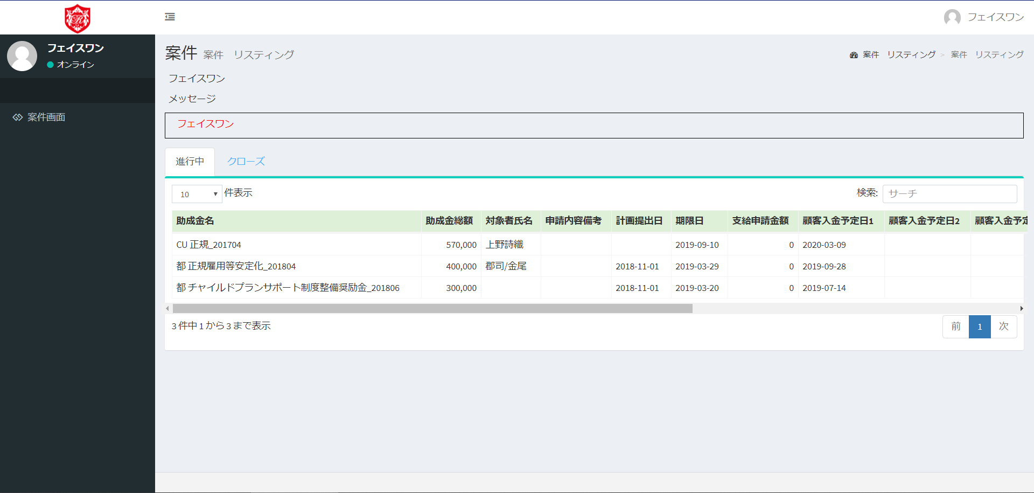
User > 案件画面
No need this Description.
No need this Description.
Please change like bellow
“顧客名” 様
Example)
フェイスワン 様

